Slide 1
Cryptocurrency Market Dynamics: A Big Data Perspective
Group 9
Dinesh Kumar Tirupanapati Rahul Kailasa
Ragghav Madderla
Sai Krishna Kathika
Varun Reddy Bhumi Reddy
Yashaswini Madineni

Slide 2
INTRODUCTION
This project focuses on analyzing cryptocurrency trading data to better understand market behavior and trends over time.
Designed to tackle the complexities of processing large-scale datasets and extracting valuable insights to improve trading strategies and risk management.
Leveraging modern cloud-based tools and big data technologies to efficiently handle, process, and analyze raw trading data.
The objective is to uncover patterns, identify risks, and enable data-driven decision-making for cryptocurrency market participants.

Slide 3
DATASET OVERVIEW
Key Features:
Price Metrics: Open, High, Low, Close prices across trading intervals.
Volume Metrics: Trade volume, quote asset volume, number of trades, and taker buy volumes.
Timestamps: Start and end times for each trading interval.
Trading Details: Includes trading pairs, time intervals, and data completeness flags.
Dataset Origin: Hugging Face 🤗
Timeframe: Jan 2020 – July 2024
Original Size: 33 GB
Analyzed Subset: 12 GB
Records: 220,722,436
Trading Pairs: 503
Granularity: 5m, 15m, 30m, 1h intervals

Slide 4
DATASET EXTRACTION
The dataset in hugging face was extracted using datasets and huggingface_hub libraries.
load_dataset() command loads the dataset to given storage file path from hugging face.
The dataset is downloaded into Arrow files and then sharding is done to combine these files.
This data is converted into CSV format using Pandas dataframe.
Install datasets library
Install huggingface_hub library
Using load_dataset()
Dataset loaded as split of Arrow files
Converting files into CSV format

Slide 5
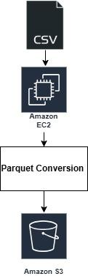
Data Conversion
Used AWS EC2 r5.2xlarge instance with 64GB RAM, 8 vCPUs and 150GB storage and secure SSH access for data processing.
Converted 33GB of CSV files to Parquet format of 12GB using chunked processing and Snappy compression.
Stored processed Parquet files in Amazon S3 with secure IAM integration.
Achieved ~1GB per minute processing speed with memory utilization below 70%.

Slide 6
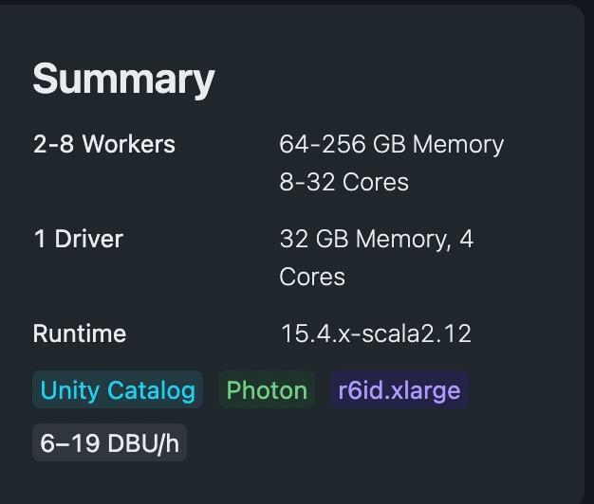
DATA ANALYSIS
Databricks Cluster Configuration
Processed Parquet files were used in Databricks for analysis using Spark.
Leveraged Spark SQL for queries on volatility, trading volume, and market patterns.
Utilized Spark’s distributed architecture to handle large-scale data efficiently.
Analyzed 12GB of data, derived insights on market activity, trading patterns, and risk levels.

Slide 7
Insights
Daily Volatility Analysis:
Volatility types (price range, high-low, and open-close) provide nuanced risk metrics.
Traders can tailor strategies based on the type of volatility they aim to exploit.
Top volatility days are ideal for high-risk, high-reward strategies but may be unsuitable for conservative traders.
Weekly Volatility Analysis:
Weekly data provides a broader perspective for swing traders.
Combining range and return volatility helps identify symbols with consistent performance.

Slide 8
Insights
Monthly Volatility Analysis:
Altcoins show higher monthly volatility than major cryptocurrencies
Monthly volatility tends to be higher than weekly volatility, suggesting accumulation of risks
Most Traded Symbols:
BTCUSDT with the highest total quote volume followed by ETH
Symbols with high volumes are less prone to market manipulation.
Spread Analysis:
High spreads often come with high risk due to market instability
Lower volume during high spreads suggests potential liquidity traps
Highest Volume Period:
PEPEUSDT dominates across multiple periods with highest volume.
Peak trading hours (14:00–16:00) align with global market overlaps, indicating periods of heightened activity.

Slide 9
Visualization
https://public.tableau.com/views/Big_data_Visualization/Story1?:language=en-US&publish=yes&:sid=&:redirect=auth&:display_count=n&:origin=viz_share_link

Slide 10
CHALLENGES
Handling our largest file of 20GB caused significant memory challenges during processing and uploading.
Uploads to EC2 were frequently interrupted, requiring efficient solutions to resume transfers.
Frequent IP address changes complicated secure access to the EC2 instance from multiple locations.
Managing system resources, such as memory and disk I/O, was critical for seamless file conversion.

Slide 11
OVERCOMING CHALLENGES
Used chunked processing to handle large files efficiently, avoiding memory overload during the 20GB file processing.
Implemented rsync to resume interrupted file uploads, ensuring reliable data transfer to EC2.
Simplified Security Group updates using automated AWS CLI scripts, enabling secure and seamless EC2 access from dynamic IPs.
Optimized resource utilization by balancing memory and disk I/O during file conversion.
Applied Snappy compression for faster processing and reduced storage size, enhancing overall efficiency.
.

Slide 12
Thank You

